Slide 1
TEACHER CUE
CFU
HINT
Scaffolding for students
MAKE THE CONNECTION
Allow students to make the connection

Slide 2
SWBAT identify series and parallel circuits and identify symbols along a circuit
TRACK WITH ME
READ WITH ME
I can identify a series and parallel circuit
I can name different circuit symbols

Slide 3
SWBAT identify series and parallel circuits and identify symbols along a circuit
What is Ohm’s law?
How are current and resistance related?

Slide 4
SWBAT identify series and parallel circuits and identify symbols along a circuit
TEACHER CUE
CFU- anyone want to try and draw an example?
Circuits
Circuits can come in two forms.
Series circuits are where all components are connected in a loop.
Parallel circuits are where components are connected between electrically common points.

Slide 5
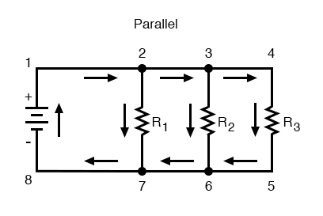
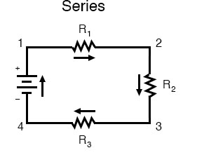
SWBAT identify series and parallel circuits and identify symbols along a circuit
Draw the images in your book

Slide 6
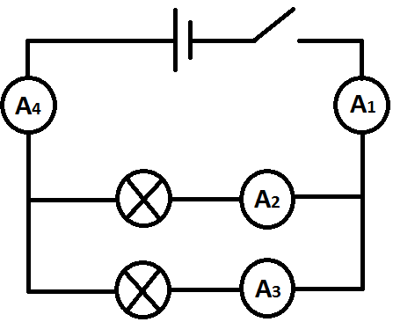
SWBAT identify series and parallel circuits and identify symbols along a circuit
Series or Parallel?

Slide 7
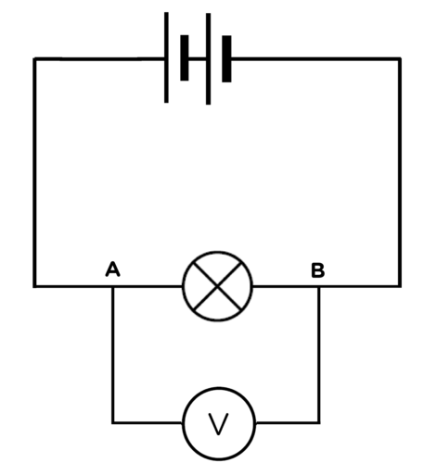
SWBAT identify series and parallel circuits and identify symbols along a circuit
Series or parallel?

Slide 8
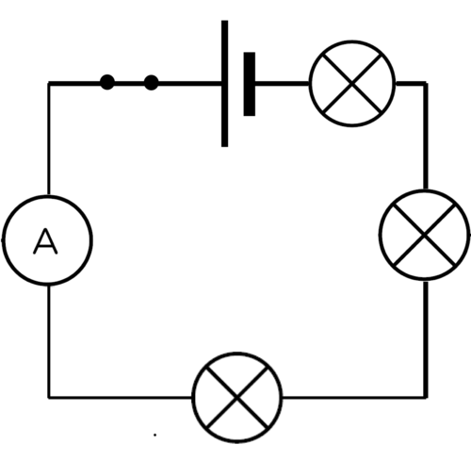
SWBAT identify series and parallel circuits and identify symbols along a circuit
Series or Parallel?

Slide 9
SWBAT identify series and parallel circuits and identify symbols along a circuit
Series circuits
In a current circuit there is only one path for the current to take. All components carry the same current
Advantages: these are simple to design and build
Disadvantages: If one light goes out, they all go out; as more lights are added they become dimmer
https://www.youtube.com/watch?v=3rdqBTTdRxc

Slide 10
SWBAT identify series and parallel circuits and identify symbols along a circuit
Parallel circuits
As current flows current has the option to move along different branches
In parallel circuits the voltage is the same throughout the entire circuit.
Advantages: -If a light blows the other lights will continue to glow.
-It is also easy to remove parts without affecting the rest of the circuit
Disadvantages: - Cannot increase voltage
Uses a lot of wires

Slide 11



SWBAT identify series and parallel circuits and identify symbols along a circuit
Which of these devices would be better for series or parallel circuits.
Notes:
For example, often lawnmowers have two switches in series with each other so that both switches need to be pressed before the mower will turn on.
Home lighting- parallel

Slide 12
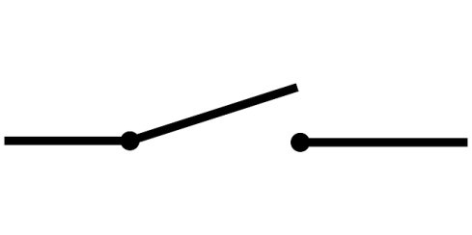
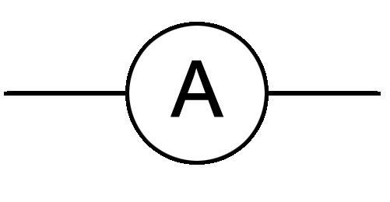

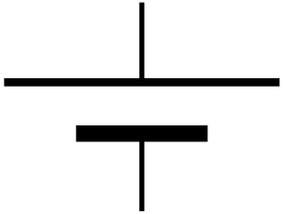
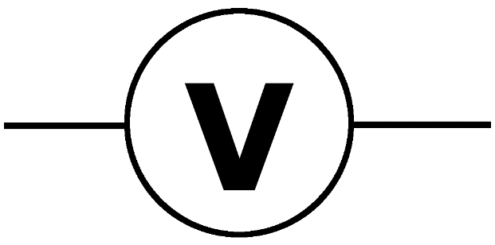

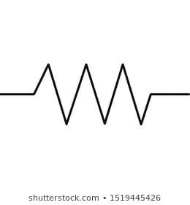
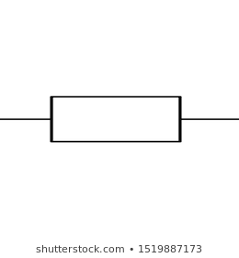
SWBAT identify series and parallel circuits and identify symbols along a circuit
Extension
Draw a series circuit and a parallel circuit with each of these symbols
When we draw a circuit we have different symbols that mean different things.
Switch
Ammeter (measure current)
Light globe
Cell or battery
Voltmeter
Wire
Resistor

Slide 13
SWBAT identify series and parallel circuits and identify symbols along a circuit
TRACK WITH ME
READ WITH ME
I can identify a series and parallel circuit
I can name different circuit symbols

